Slide 1

FindMyCar User Guide
Developed by Daeik Kim

Slide 2
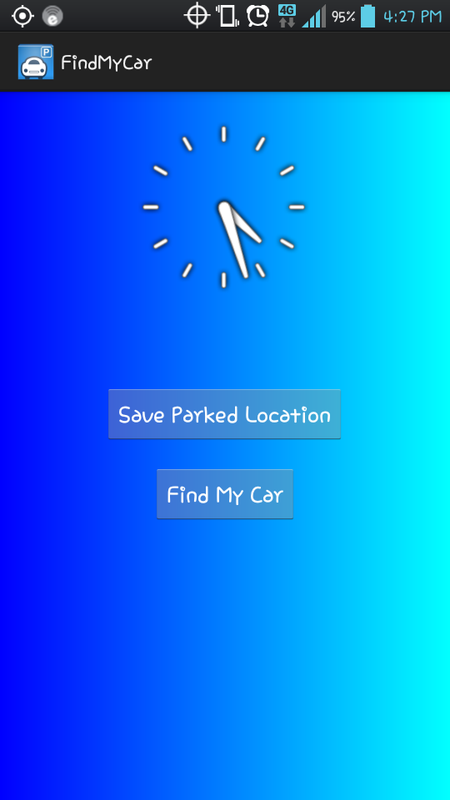

Main Menu
Little mini analog clock just for fun :D
Two Functions
Save Parked Location
Find My Car

Slide 3
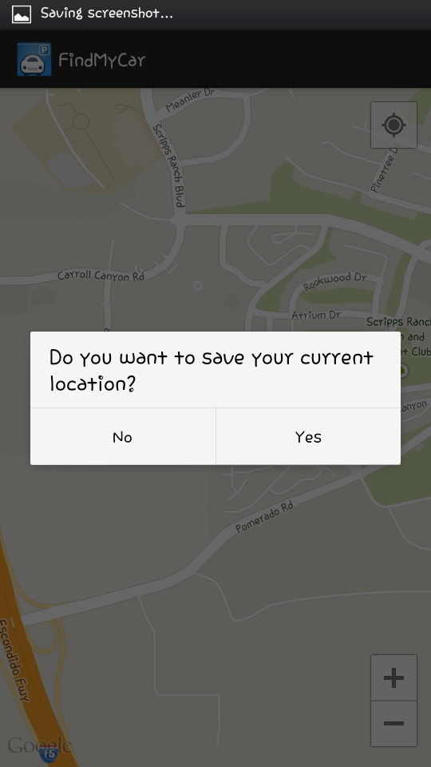
Save Parked Location
Once you press on the “Save Parked location” button, a prompt will appear.
Press yes to save your current location, or press no to cancel.

Slide 4
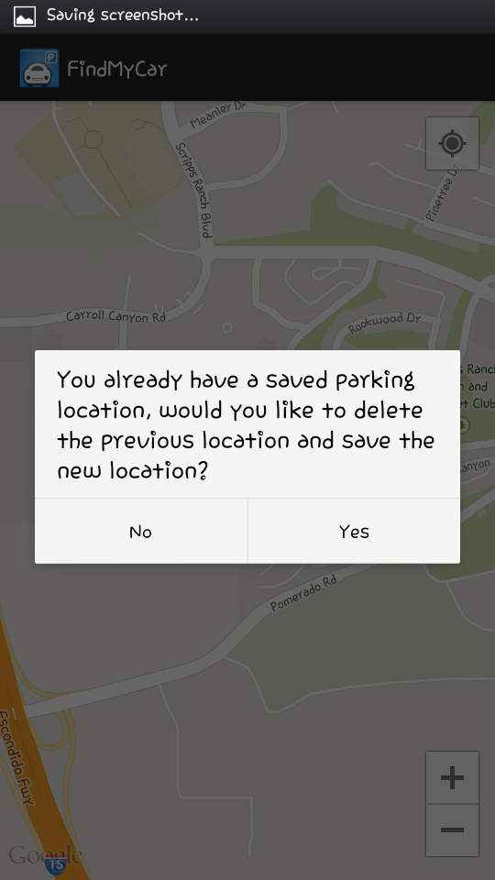
Save Parked Location
After you press yes from previous prompt, if there is a saved parked location already, another prompt will appear.
Press yes to overwrite the parked location, or press no to cancel.

Slide 5
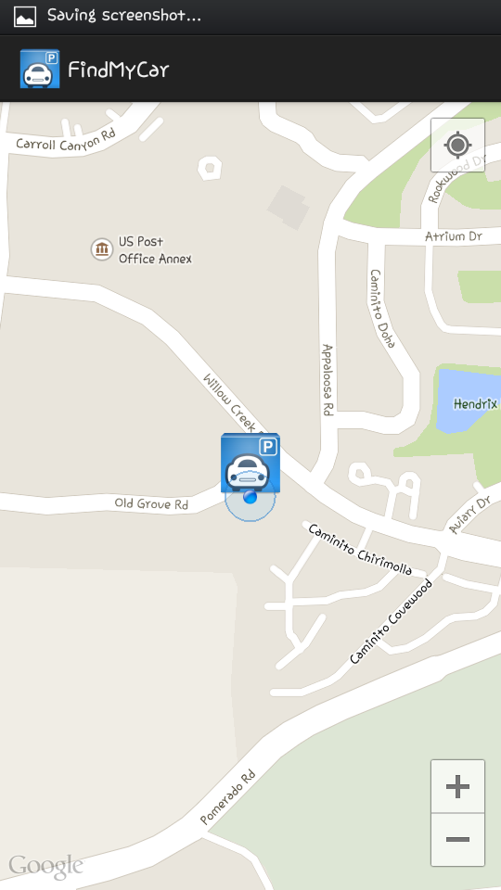

Save Parked Location
After you click yes from previous prompt, a marker should appear on map activity to mark your parked location.

Slide 6
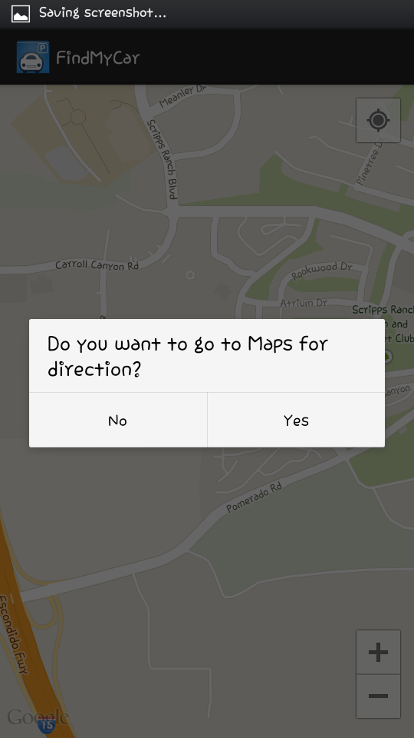
Find My Car
Once you press on “Find My Car” button, a prompt will appear.
Press yes to use maps to navigate, or press no to move to your parked location.

Slide 7
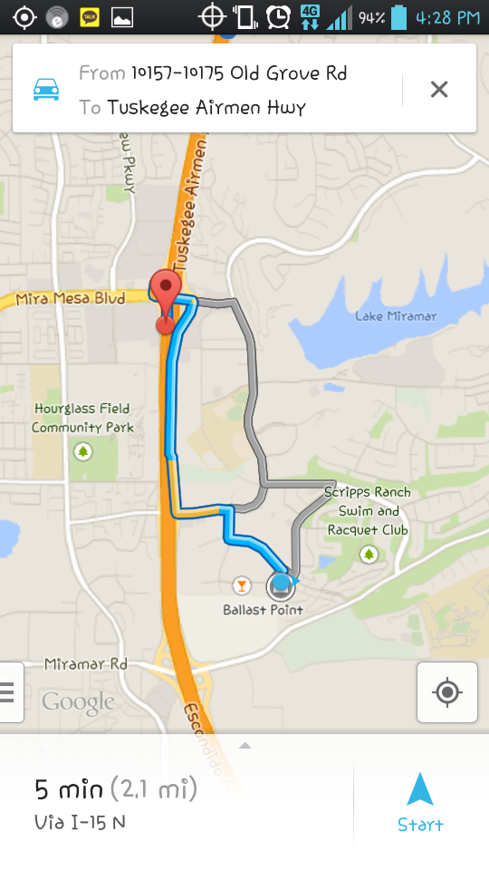

Find My Car
If you pressed yes from previous prompt, you will be redirected to Maps app to navigate

Slide 8
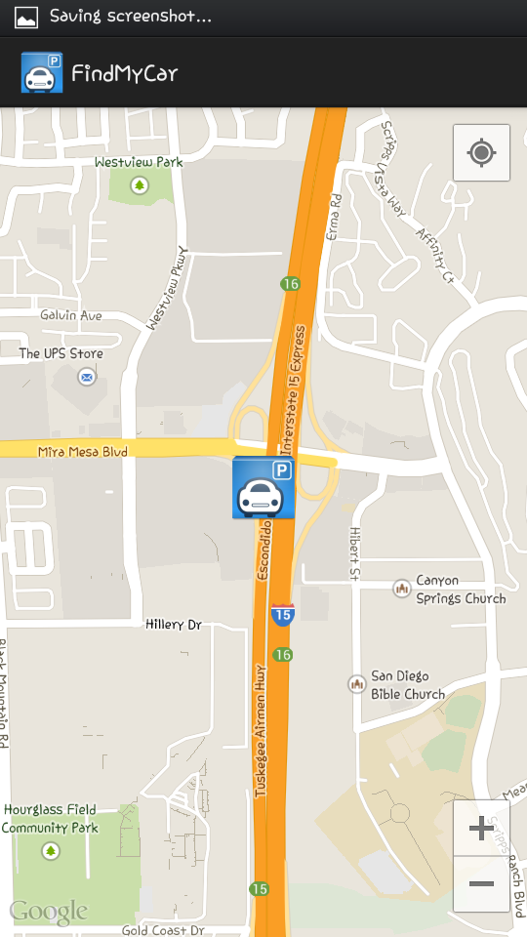
Find My Car
If you pressed no from previous prompt, you will move to the saved parking location with a marker locating the position.

